Slide 1
Think with Our Eyes

Slide 2



Today’s Plans
Talk Movies Activities

Slide 3
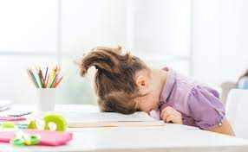
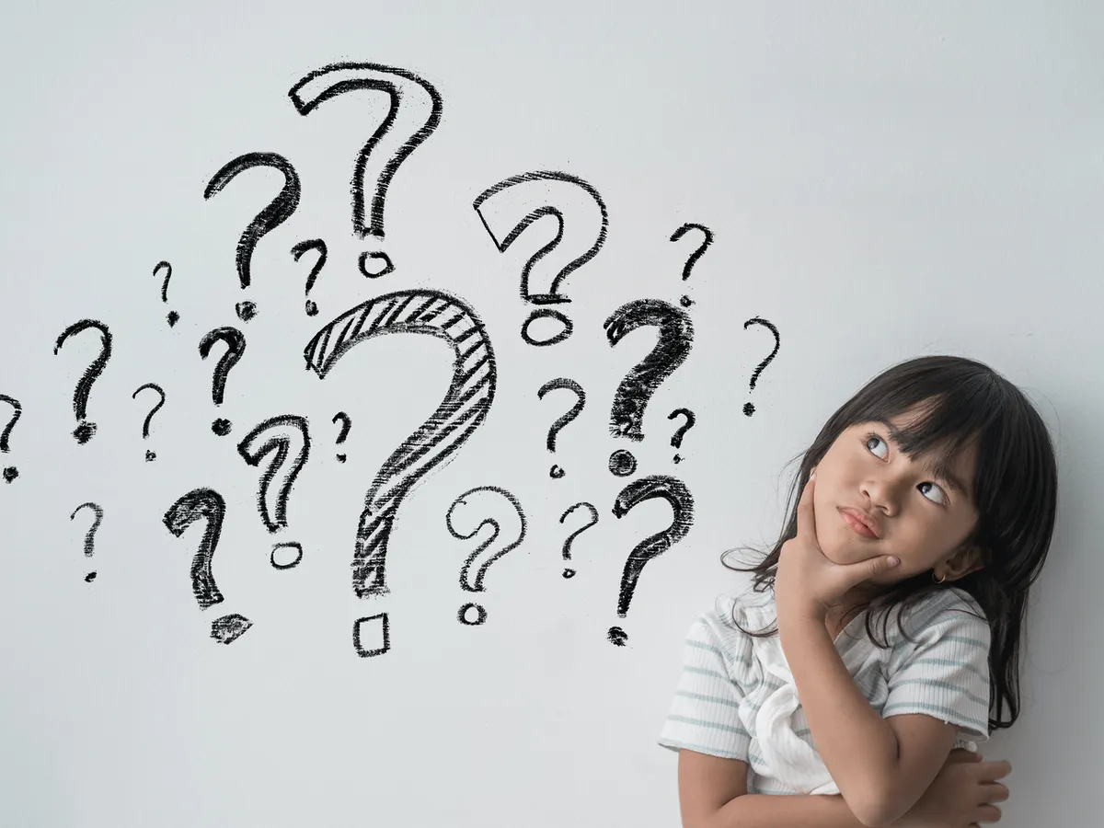
Can you answer my questions?
Head on desk Can you answer my questions?
Why or why not?

Slide 4
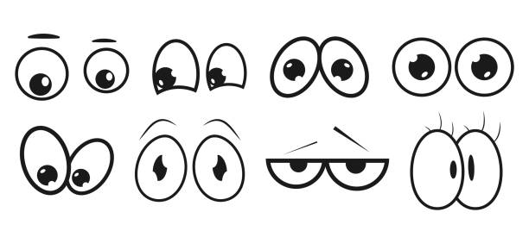
Our eyes help us think
What I’m looking at tells people what I’m thinking about.

Slide 5
Look at me and guess
What am I looking at?
What am I thinking about?

Slide 6
Watch the movie clips
Angry Birds: https://youtu.be/1Bk_nqUQ0fc
Frozen: https://youtu.be/TeQ_TTyLGMs

Slide 7
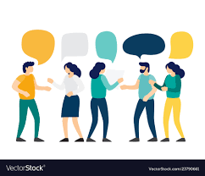
Eye contact tells us who we are talking to

Slide 8
Activity: Make eye contact and ask questions

Slide 9
Eye contact tells us what we want
I have a bouquet of flowers. I ask, “who wants it?”
Ms. M wants it. Can she let me know without talking?

Slide 10
Activity: Use eye contact to talk

Slide 11
Eye Yoga
https://youtu.be/stx50VtfqTU

